Slide 1

COMPUTER VIRUSES
&
ANTIVIRUSES

Slide 2

What is a computer virus?
A computer virus is a malicious program designed to infiltrate systems and cause harm. Viruses spread through files, emails, and networks, impacting devices worldwide.

Slide 3


Slide 4
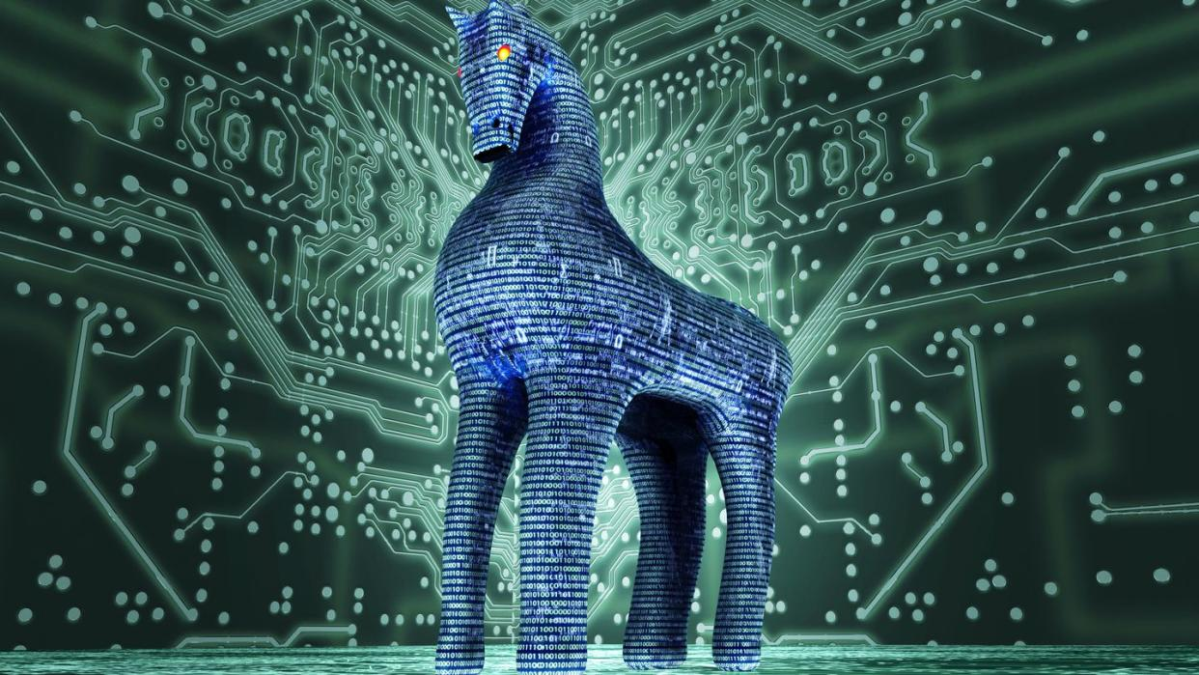

Slide 5
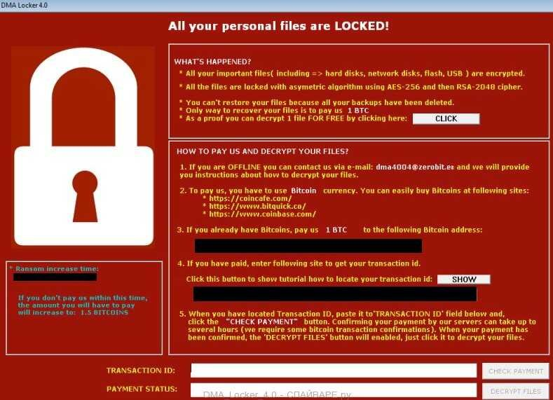

Slide 6
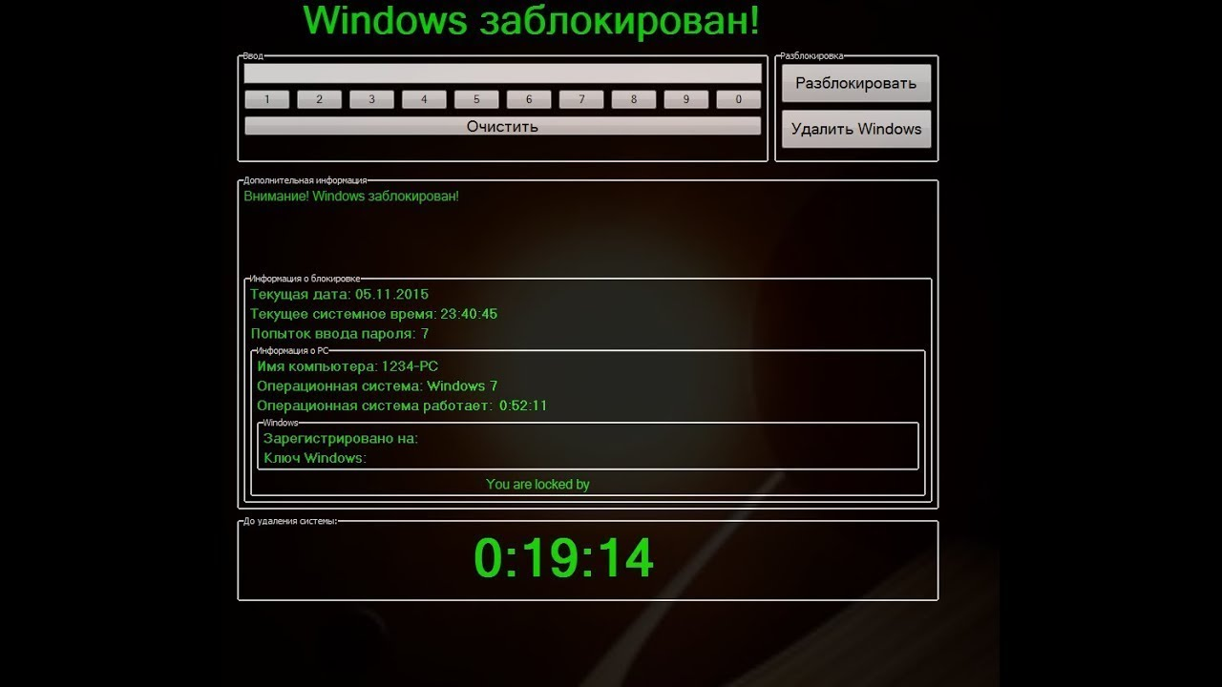

Slide 7


Slide 8
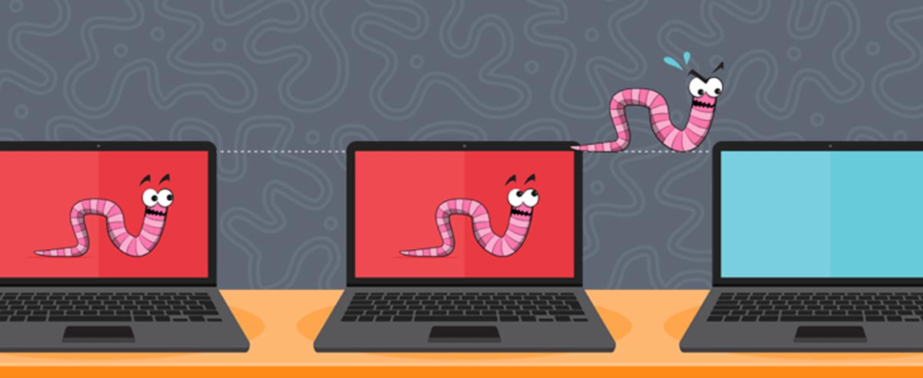

Slide 9
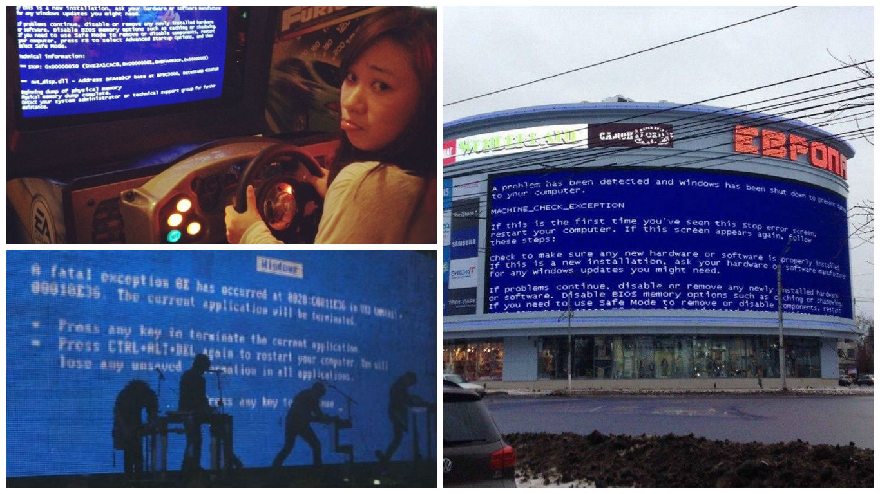

Slide 10

Importance of Digital Hygiene
Regular updates
Verifying links
Using complex passwords

Slide 11
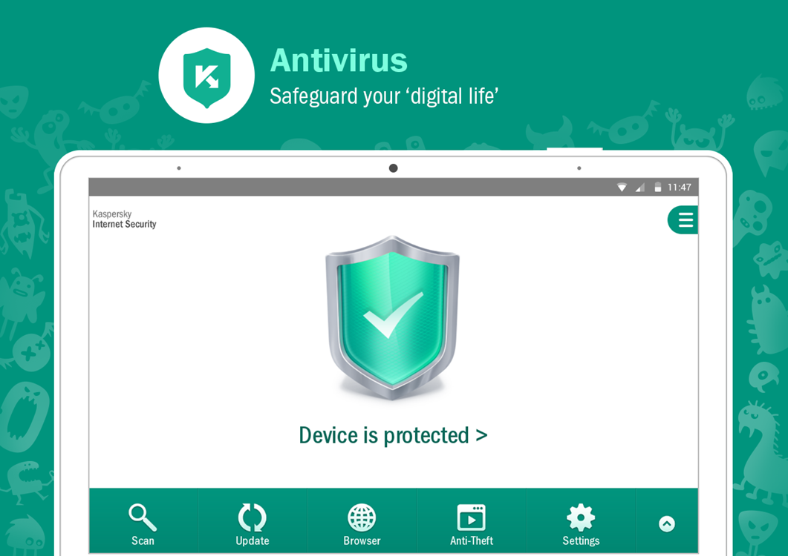

Slide 12
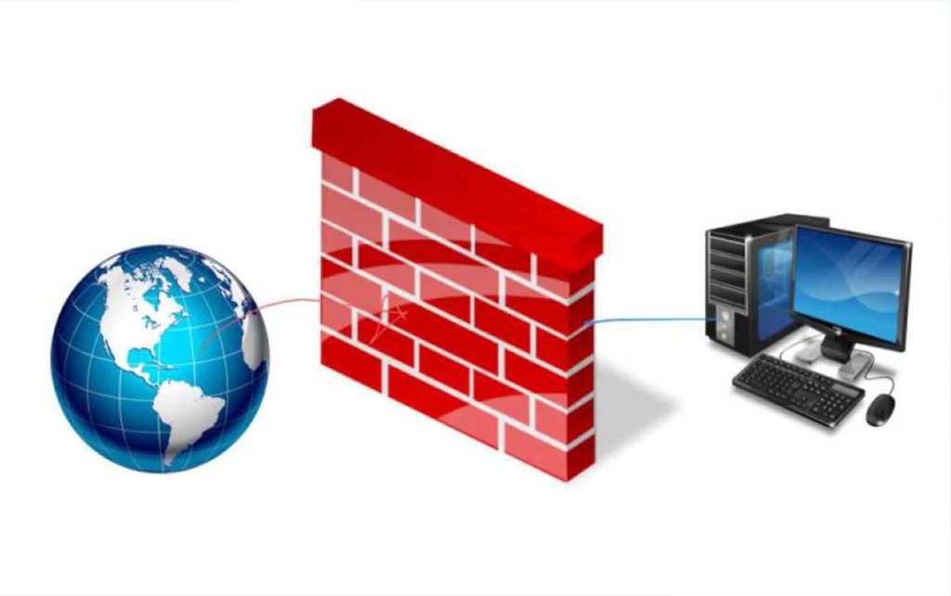

Slide 13

Advanced Security Measures
Regular backups
Intrusion detection systems
Endpoint protection

